Slide 1
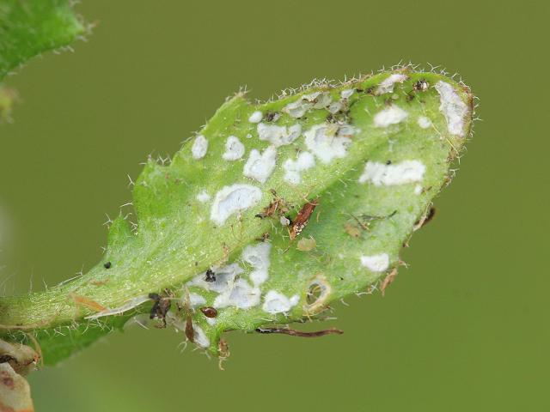
Albugo candida workshop
01/08/2017
An overview of the biology of Albugo candida.
Practical session 1: demonstrate the identification of recognized effector candidates transiently in Nicotiana tabacum by HR assay.
02/08/2017
An overview of Hyaloperonospora arabidopsidis and the use of biolistic gene gun as a means to localize and /or identify weakly recognized effector proteins by bombardment.
Practical session 2: examination of the colonization of A. candida and Hpa infected tissue with tryphan blue staining.

Slide 2
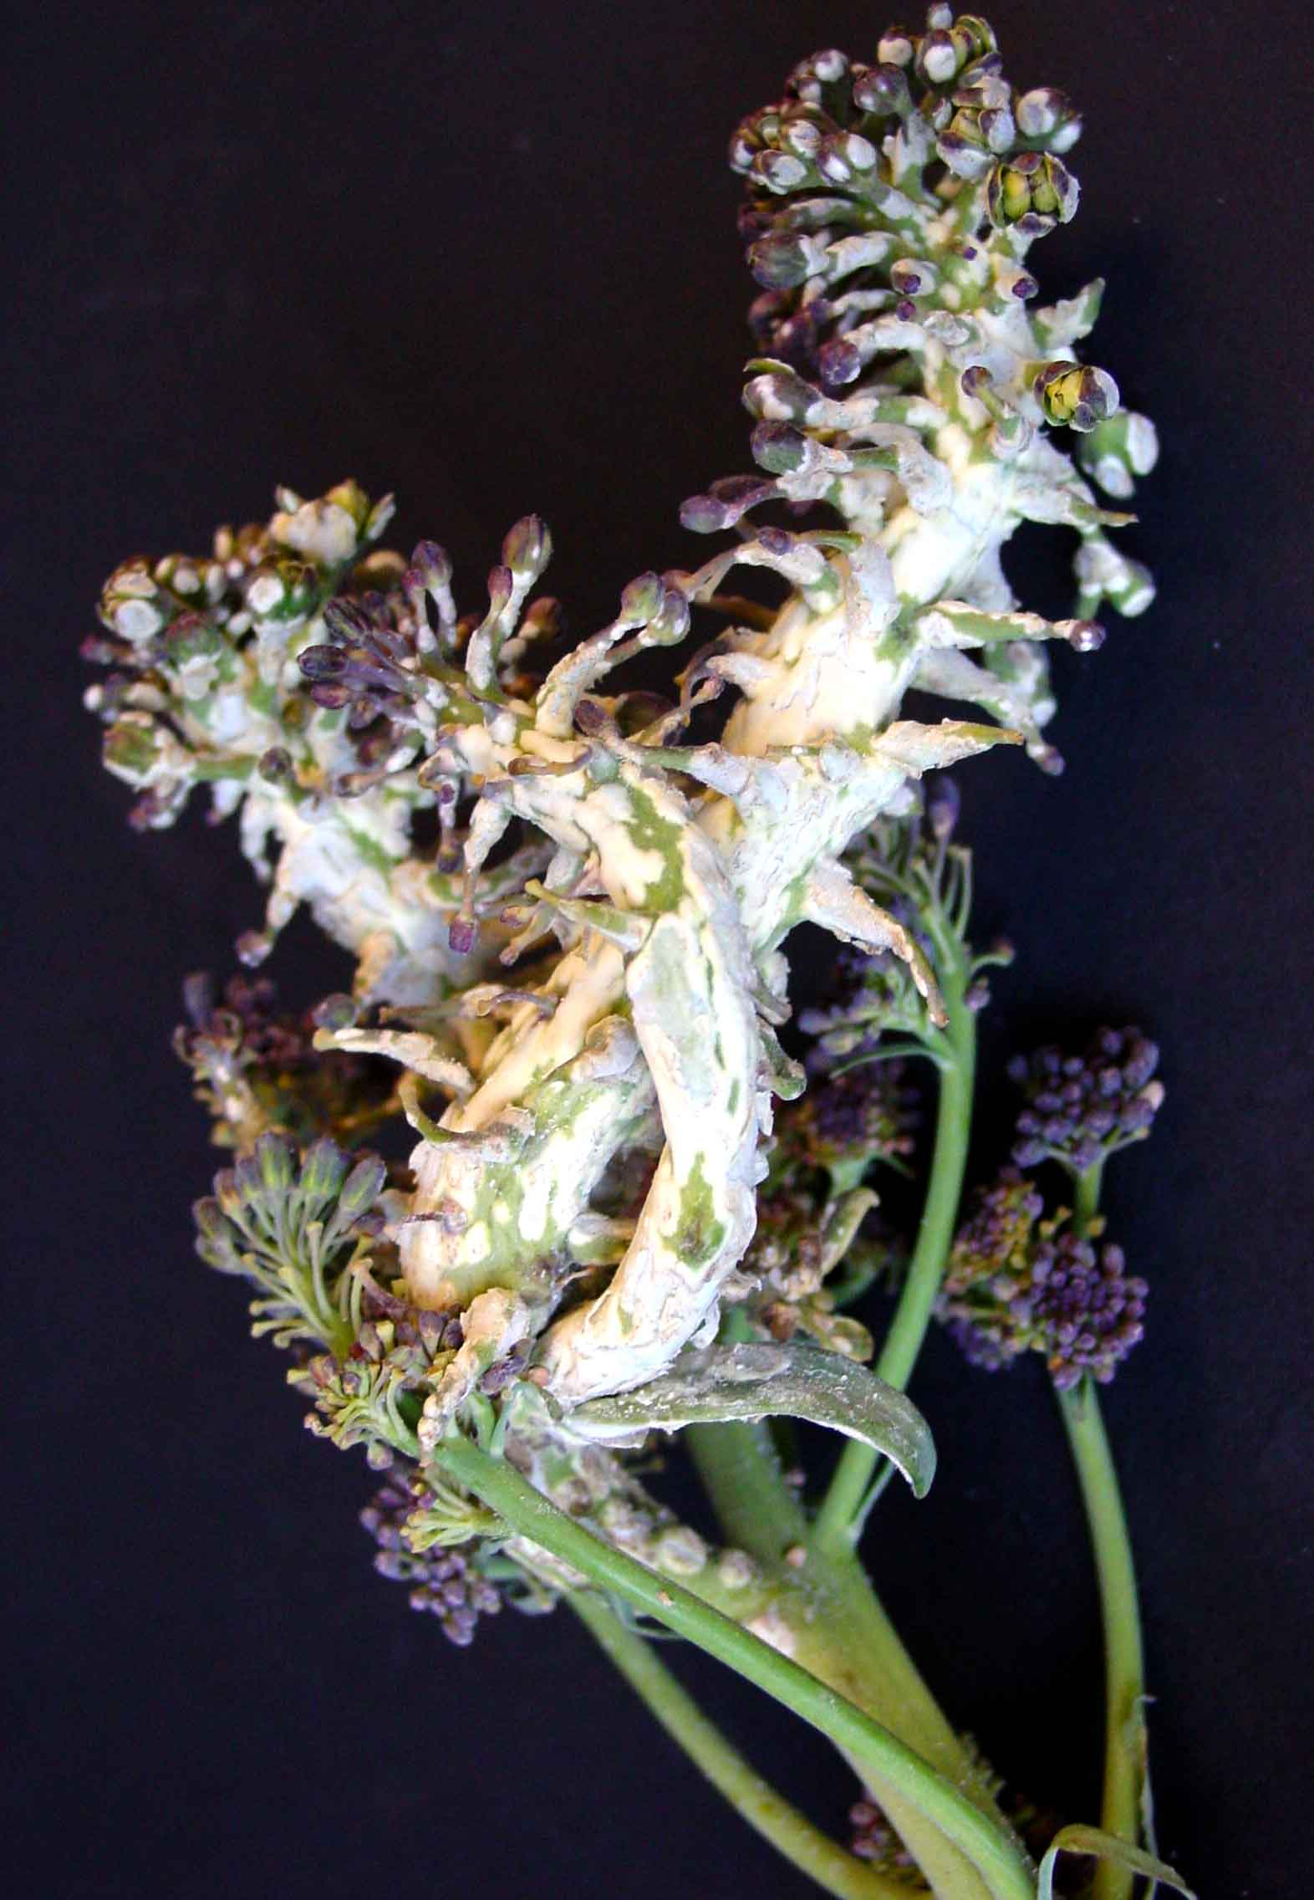
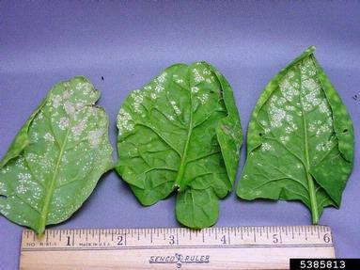
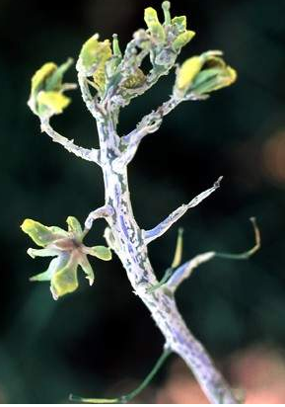
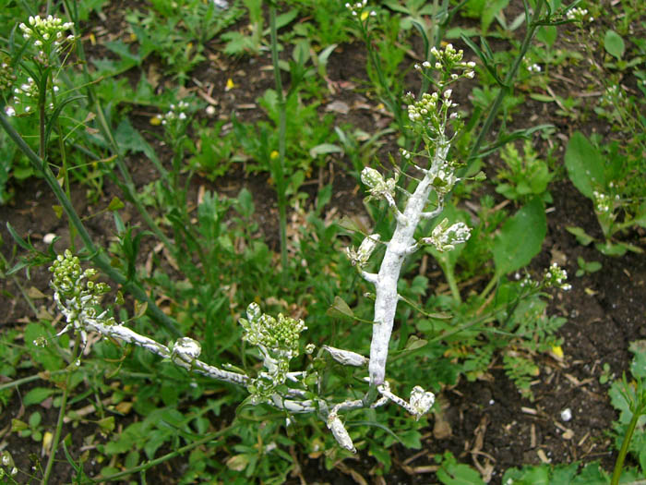
Albugo sp. and relatives are pathogens of most if not all plants of the Brassicaceae family
A. occidentalis on spinach
A. candida on B. juncea
A. candida on broccoli
Albugo sp. on Arabidopsis
A. candida on Cardamine
A. candida on oilseed

Slide 3
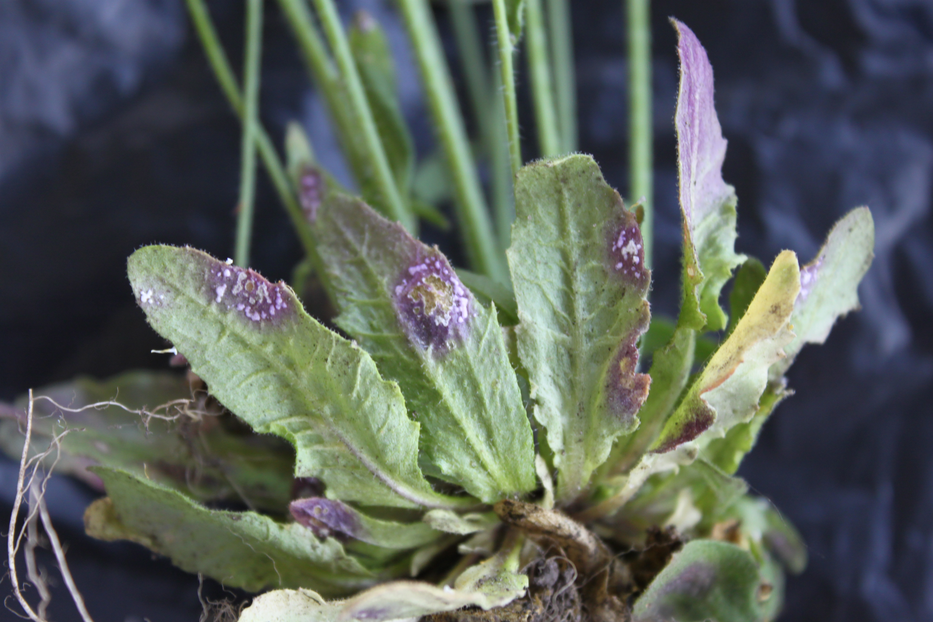
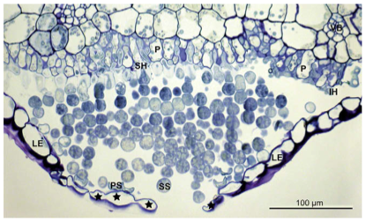
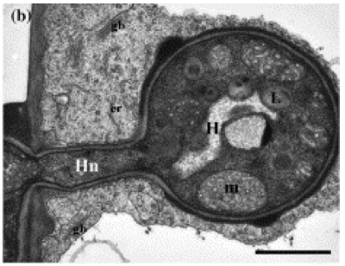
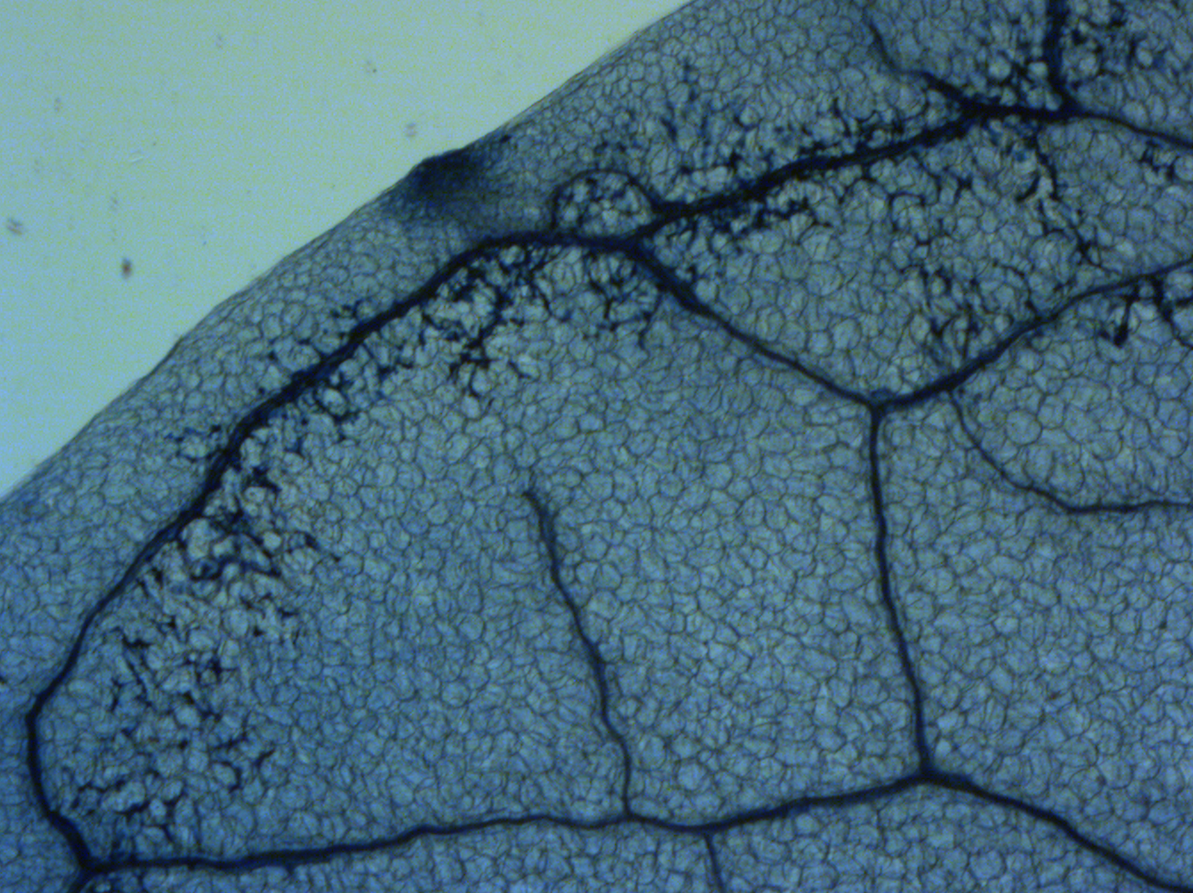
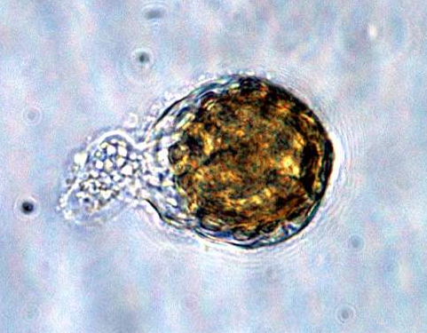

Slide 4
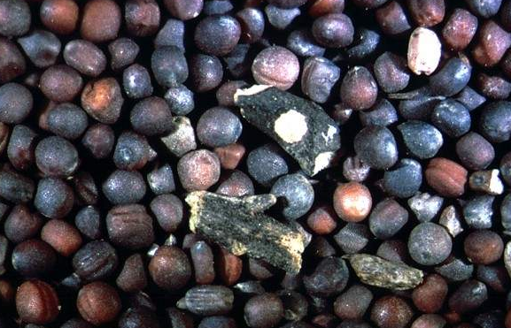
What is the economic impact of Albugo?
Highlights:
Worst ever epidemic reported was Haryna, India in 1989; Albugo infections of B. juncea (mustard) cv. Prakash caused 89.8% yield loss!
Yield losses from 21.3-37.2% in B. juncea are typical in North Eastern India.
Yield losses from 5-10% in B. rapa are typical in Australia.
Yield losses from 3-9% in B. rapa are typical in Canada.
Albugo also causes disease in a wide range of smaller crops, losses vary from year to year
There are currently no reactive chemical or biological controls- the disease is controlled only through the breeding of resistant varieties
Info: Centre for Agriculture and Biosciences International

Slide 5
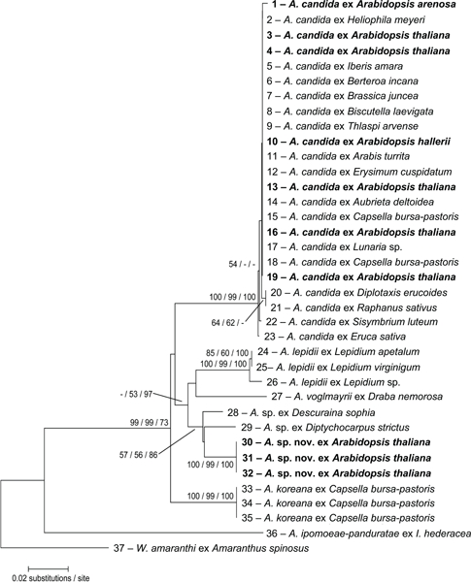
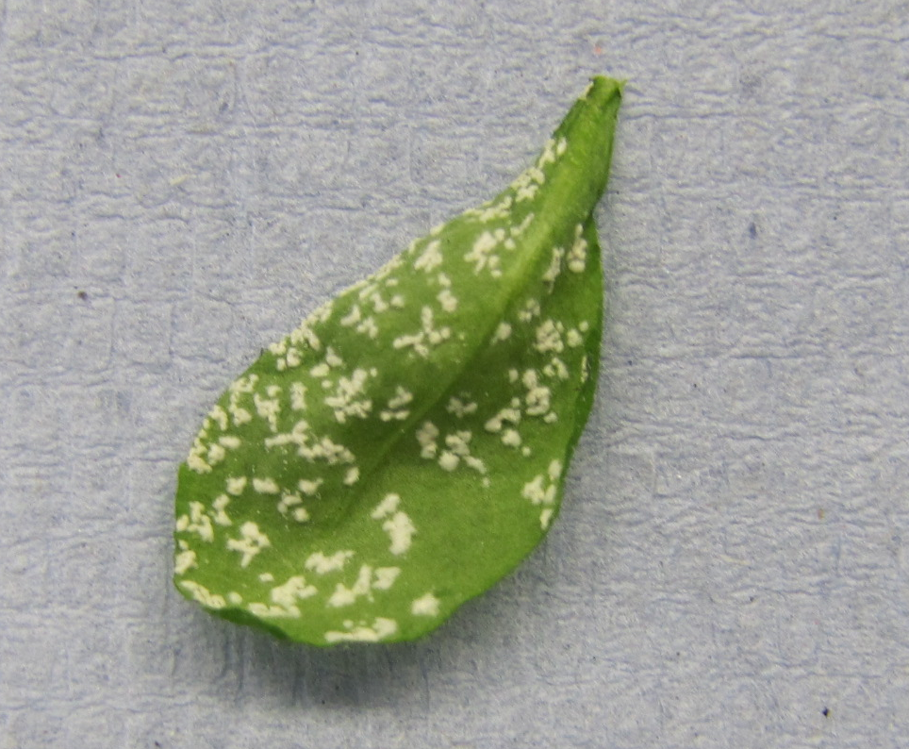
Albuginales
Albugo candida
Albugo laibachii
Specialized on A. thaliana

Slide 6
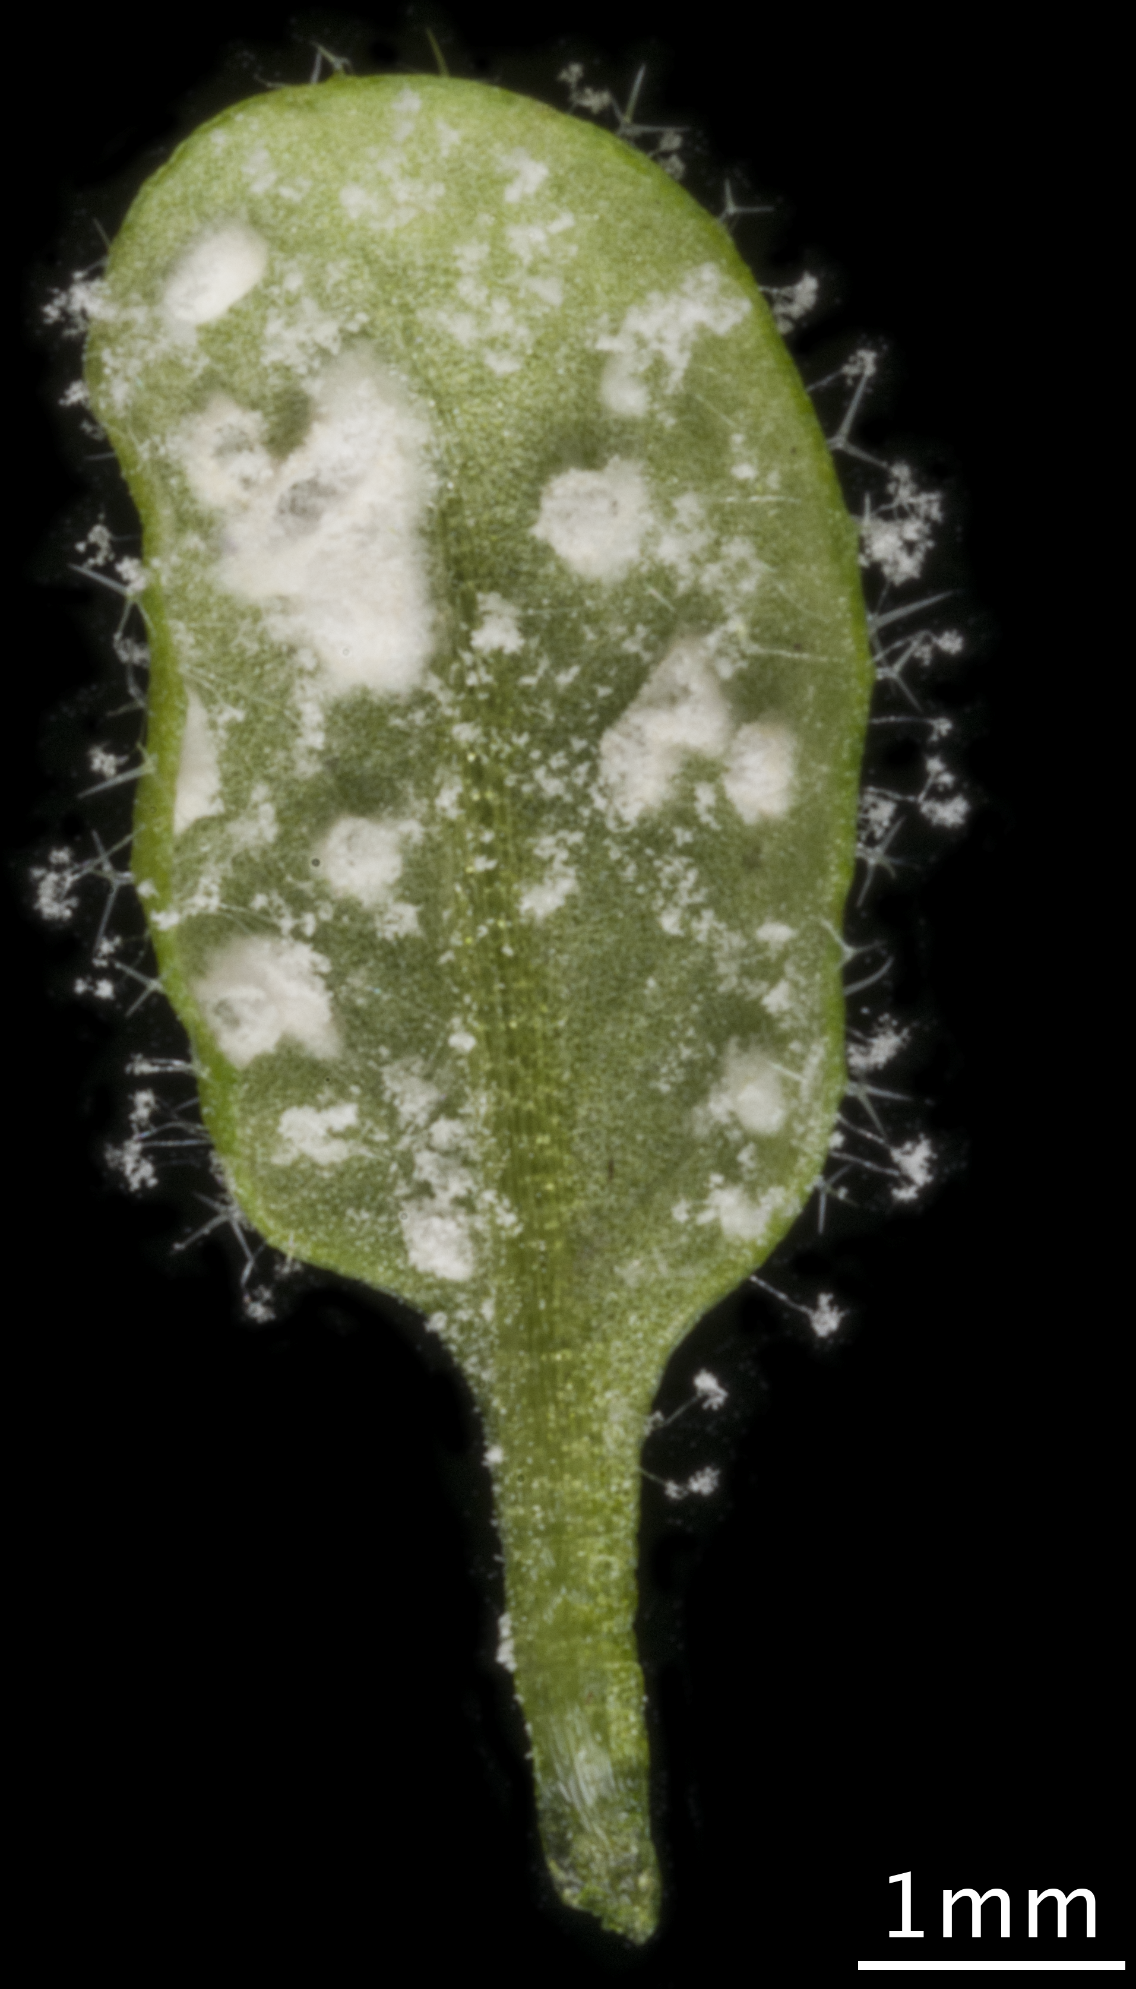
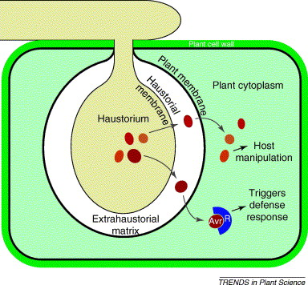
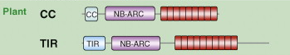
Albugo suppresses plant immunity
BUT- plant R proteins recognize biotrophic effectors and trigger strong immunity and cell death
Most plant R proteins are “NB-LRRs”
LRR
Albugo laibachii – allows secondary growth of avirulent pathogens on Arabidopsis thaliana

Slide 7
CCG effectors in Albugo
1
28
47
56
Typical CCG
SP
CCG
A. laibachii
A. candida

Slide 8
The U’s triangle model describes the relationship among brassica crops
Arabidopsis thaliana
n=5

Slide 9
A. candida races show host specificity
Host Species Specificity
Albugo candida Races | Natural Host | Brassica juncea | Brassica rapa | Brassica oleracea | Arabidopsis thaliana
Ac2v | Brassica juncea | Sus | Res (Sus) | Res | Res
Ac7v | Brassica rapa | Res | Sus | Res | Res
AcBoT | Brassica oleracea | Res | Res | Sus | Res
AcNc2 | Arabidopsis thaliana | Res | Res | Res | Res/ Sus
AcEm2 | Capsella pastoris | Res | Res | Res | Res/ Sus
AcEx1 | Arabidopsis halleri | Res | Res | Res | Res/ Sus

Slide 10

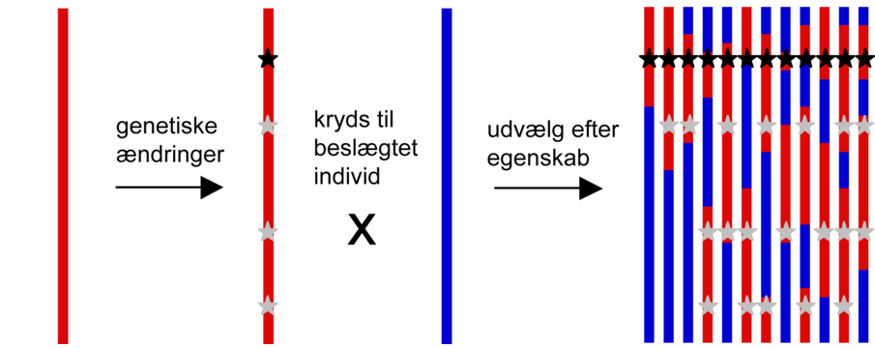


Classical genetic mapping (single dominant locus scenario)
Use genetic markers (~PCR) on 100s of recessive trait F2s
Susceptible F2s; 25% of population
Susceptible
Resistant
‘A’
‘B’
1
2
3
4
5
6
75% A
R gene locus
100% A
75% A
F1 ALL HETEROZYGOUS
(show dominant trait)
- continue to F2 population
50% A
50% A
50% A

Slide 11
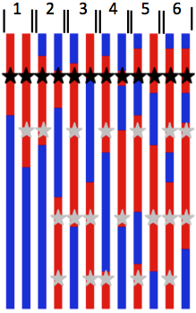

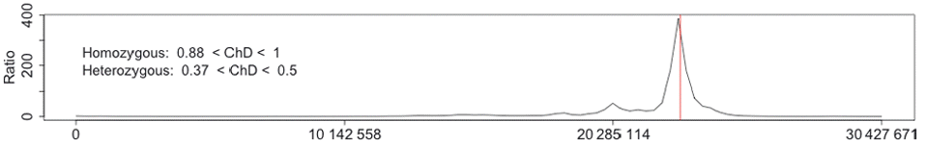
Illumina based genetic mapping AKA next generation mapping
Bulk 100s of F2 susceptible DNA samples into one mix
High depth Illumina genotyping by sequencing
Homozygous/heterozygous SNP analysis on F2 bulk reads

Slide 12
Col-0 possesses polygenic resistance to A. candida
WRR4
WS-2
CW5
Cw14
CW20
Col-0
WRR4: recognizes races 2, 4, 7 and 9 (Borhan et al, 2008)

Slide 13
Albugo practical task: Identify effectors recognized
by WRR4
Transient expression of the R-gene and recognized effector in tobacco
elicits a hypersensitive response.
You have been provided with 6 effectors from A. candida race AcNc2 and
WRR4 (Col-0) GV3101
In groups of 4 , please co-infiltrate tobacco with WRR4 and each effector
We will see if one, or more effectors are recognized tomorrow!
Non - recognized
Recognized

